Slide 1
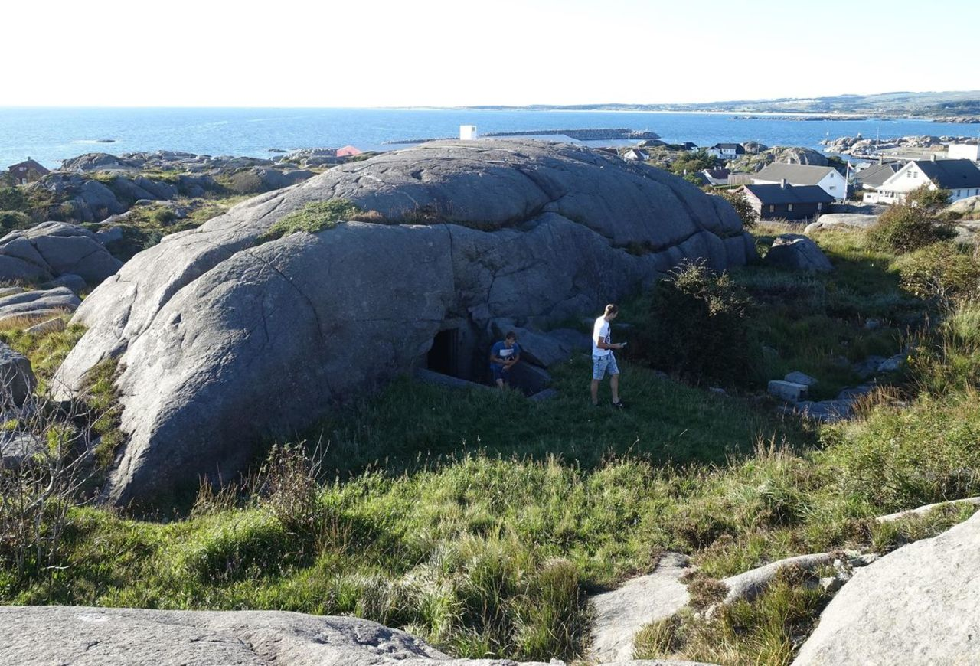
War memorial in Hå
For many years, it was probably only the most local Hå-buane who knew how the pierced Vedafjellet in Sirevåg was made of tunnels and bunkers with fathers after cannon emplacements. It took many years before this area was released to most people. Today it is one of the clearest war memorials in Hå.
At Vedafjellet there was a lot of activity during the war. The civil organization "Todt" carried out the blasting and construction work. They made use of discharged crew from Eigersund, and prisoners of war, Poles and Russians, from camps in the Eigersund area.
In the summer of 1943, the facility was completed and the four 8.8 cm cannons were placed in a "square" on top of Vedafjellet.
The guns, originally Russian anti-aircraft guns of caliber 8.5 cm, the Germans had drilled up by 0.3 cm.
The range was 15 kilometers.

Slide 2
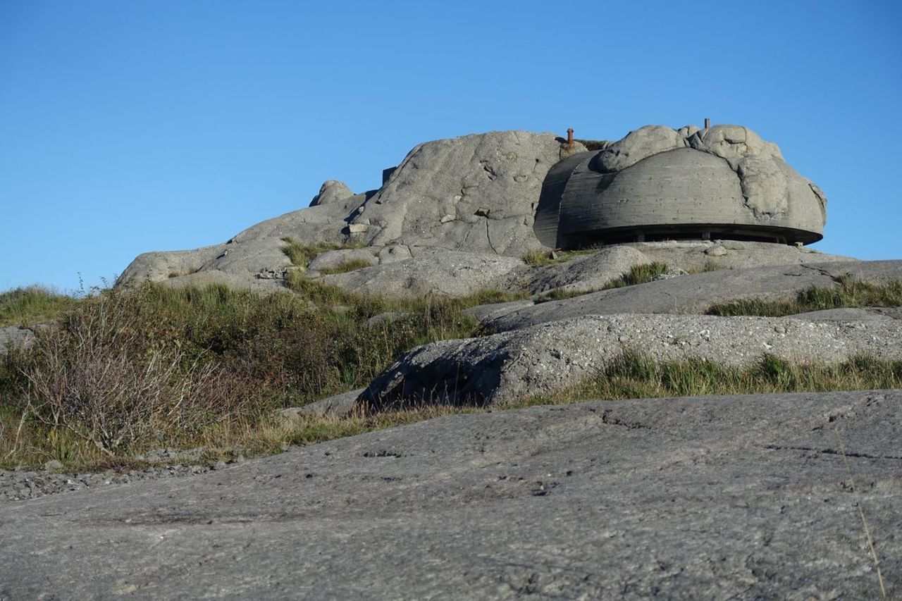
The quartet on Vedafjellet was controlled via electric cable from the central sight in the command bunker, so that everyone aimed at the same target at the same time. It is reasonable to believe that the quartet could fire around 60 shots per minute.
Several times the cannons were fired. It was during test firings on a shipwreck on the islet of Raunen north of Ognabukta, during allied attacks on German convoys and when 70-80 allied planes flew over the area. They were going to bomb Knaben. No one in the area registered an aircraft that went down after a direct hit.
On Vedafjellet there were also several 2 cm anti-aircraft guns, a 5 cm anti-tank gun, a position for 20 mm twin machine guns, stationary flame throwers, trenches for close defense on the north side and emplacement barracks.
And everything was fenced off with a deterrent barbed wire fence!
There was often shooting and skirmishes at sea in the Sirevåg area, but despite everything relatively calm. Or as one said: "One felt it closer than it was". At the end of 1944, British planes attacked a German convoy outside Sirevåg. Boats sank, and local fishermen assisted in the rescue work.
A lot of wreckage was picked up. And the fish in the sea died as a result of the pressure from the explosions and washed up.
500 kg of lyre was exchanged for a boat.

Slide 3
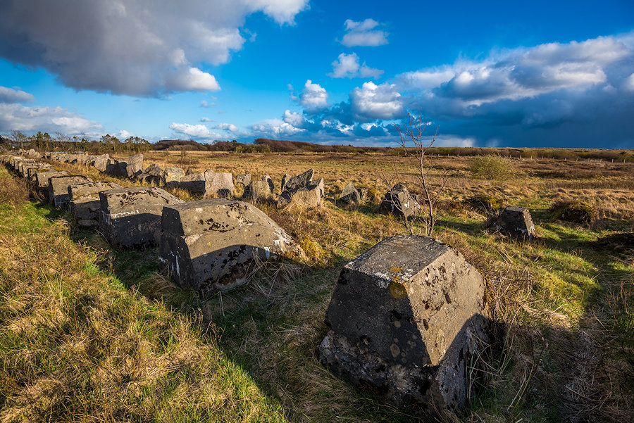
Hitlertenner ved Brusand
If you drive Nordsjøvegen, county road 44, past Brusand, it will be difficult not to notice the mighty row of Hitler's teeth along the road. The Hitler Teeth were built here during the Second World War as an obstacle to tanks and amphibious vehicles. Hitler's teeth were part of a defense structure that was built on Jæren under the auspices of Germany during the Second World War. The Germans feared an attack from the sea, and in order to stop Allied tanks and amphibious vehicles, wide minefields were laid on the beach and further up, large boulders were placed in several rows. Several hundred men had to take part in this work, most of them forcibly sent from Jæren, Egersund and Stavanger. And eventually Hitler's Norwegian defense was completed to protect the Germans against attacks from the sea. The Hitler Teeth are part of the Atlantic Wall.

